Slide 1
Revenue Trends and Customer Segments

Slide 2

Content
1. Revenue Trends and Customer Segments
2. Sales Channel Distribution and Regional Performance
3. Customer Segments and Product Category Sales

Slide 3

Revenue Trends and Customer Segments
Section 1

Slide 4


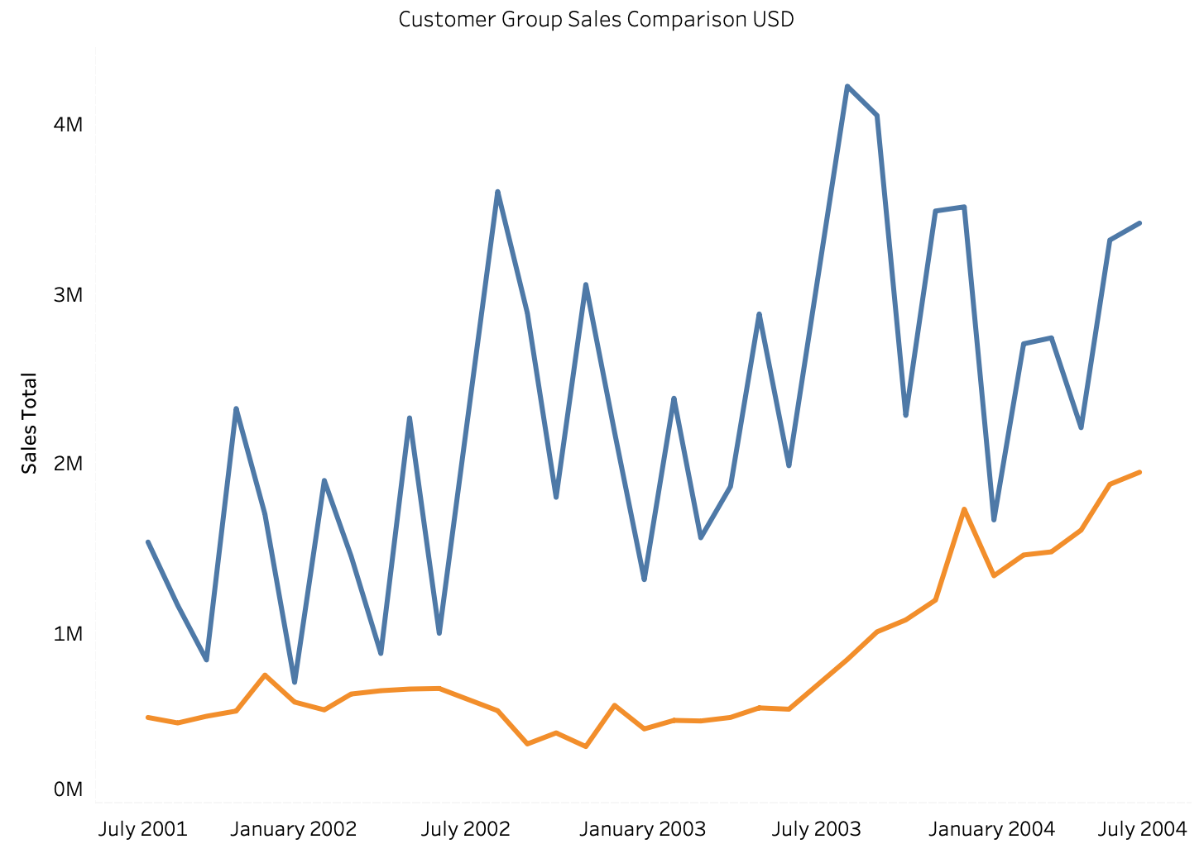

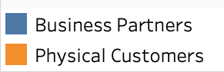
Revenue Growth Pattern
Increasing Revenue
01
The company's revenue has shown a consistent upward trend over the years, indicating sustained growth.
02
Digital Market Expansion
Online sales have steadily increased since 2003, reflecting the success of the company's digital market expansion efforts.

Slide 5
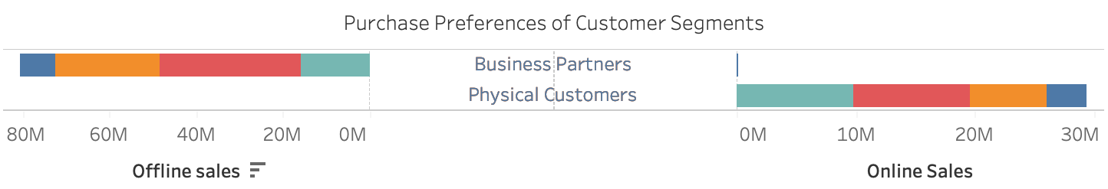
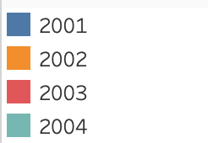
Physical Customers tend to make online orders while partners make wholesale contracts and offline sales
Understanding these preferences can help tailor marketing and sales strategies to each segment's behavior.

Slide 6
Sales Channel Distribution and Regional Performance
Section 2

Slide 7
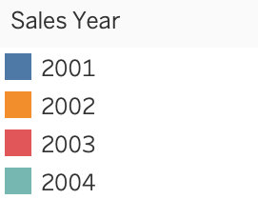
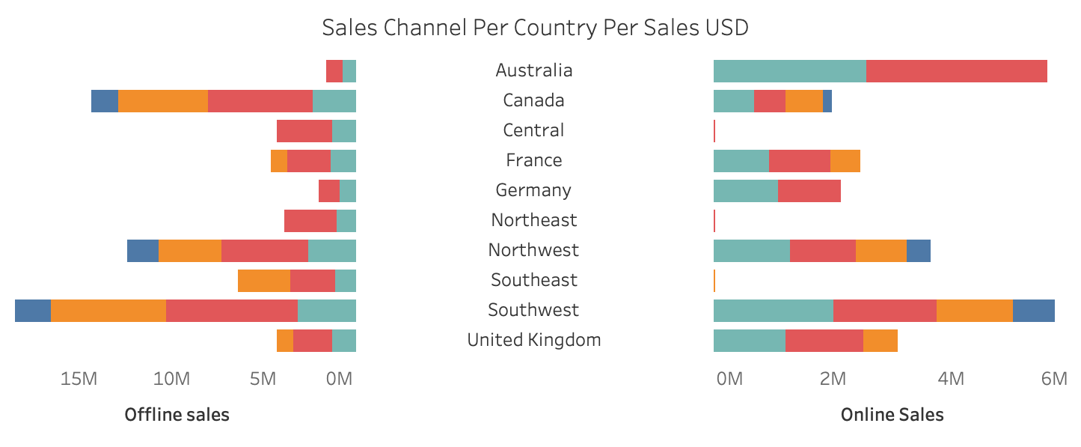
Sales Channel Analysis
01
02
Effective Sales Channels
Regional Impact Performance
Analysis of sales channels reveals the effectiveness of various distribution methods in reaching customers.
The performance of sales channels varies across different regions, influencing overall sales performance.

Slide 8

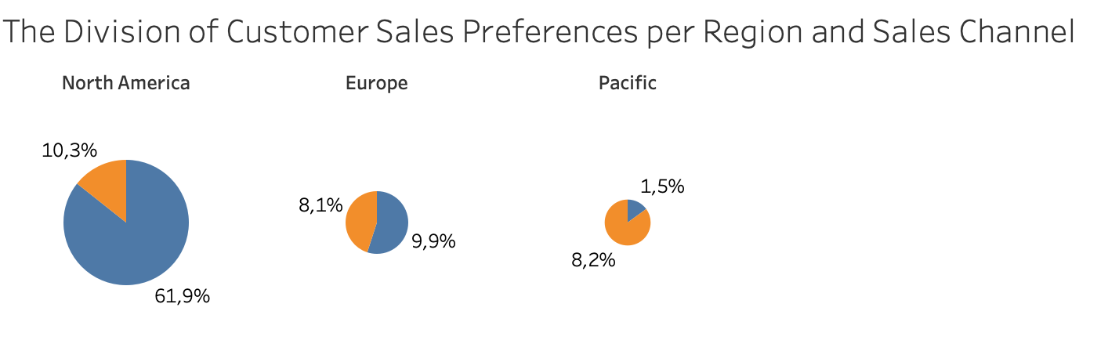
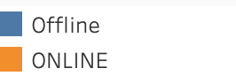
Revenue per Customer Group
Customer Group Revenue Analysis
Analyzing revenue generated from different customer groups helps in identifying high-value segments and tailoring marketing strategies accordingly.
Growth Opportunities
Identifying potential growth areas within customer segments can drive revenue optimization strategies.

Slide 9

Customer Segments and Product Category Sales
Section 3

Slide 10
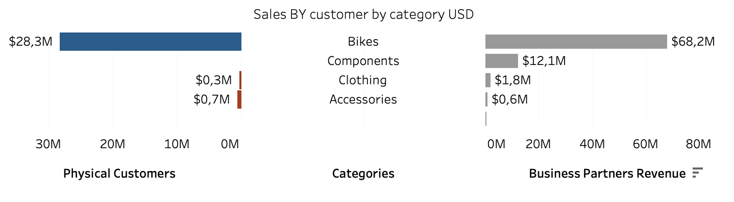
Sales Analysis per Customer Segment and Region
Segmented Sales Analysis
Understanding sales performance across customer segments provides valuable insights for targeted marketing and product development.
Regional Sales Impact
Regional analysis of product category sales highlights variations in consumer preferences and demand.
01
02

Slide 11




SWOT Analysis
Strengths
The company's increasing revenue and successful digital market expansion are key strengths, positioning it for further growth.
Weaknesses
Limited regional performance and potential gaps in customer segment targeting present areas for improvement.
01
02
Opportunities
Leveraging regional performance insights and targeting specific customer segments presents growth opportunities.
Threats
Market saturation and evolving consumer preferences pose potential threats to sustained revenue growth
03
04

Slide 12

Thank You

